Slide 1
Patient Care Connect
How to Keep Your Patient Out of the ED
Edward E. Partridge, MD
Director Emeritus & Professor Emeritus
UAB Comprehensive Cancer Center
Medical Director, UABHS Cancer Community Network
Chief Medical Officer, Guideway Care

Slide 2
Disclosure
This work was supported by the Grant Number 1C1CMS331023 from the Department of Health and Human Services, Centers for Medicare & Medicaid Services. The research presented was conducted by the awardee. The contents of this presentation are solely the responsibility of the authors and do not necessarily represent the official views of the U.S. Department of Health and Human Services or any of its agencies.
Dr. Partridge is Chief Medical Officer, Guideway Care.

Slide 3
Navigation at UAB
$ $ First 12 Months
$ Continuing Phase
$ $ $ Last 12 Months
Early Detection
Evaluation & Treatment Planning
Active
Treatment
Post Tx
Follow Up
Survivorship & Surveillance
Palliative & Hospice
Prevention
Community Health Advisor (Screening & Awareness)
Community Navigators (Non-nurse)
Clinical Trial Navigators (Non-Nurse)
IMCCP Navigators (Non-nurse)
CMS Patient Navigators (Non-nurse)
Focus
Diet & Exercise
Tobacco Control
Risk Management
Age Appropriate Screening
Prompt Evaluation
Accurate Diagnosis
Accurate Treatment Plan
Complete Treatments
Coordination of Care
Avoid ED
Clinical Trials
Stay on Medications
Manage Comorbidities
Regular Surveillance
Manage Comorbidities
Physical Activity / Healthy Diet
Advanced Disease Management & Planning

Slide 4
2012 CMMI Innovation Award
Patient Care Connect Program
Goal of improving VALUE
~40 Lay (non-clinical) navigators
Provides extra layer of support to cancer patients across the continuum of care
Activities anchored by distress screening
RocqueGB, et al. The Patient Care Connect Program: Transforming Health Care through Lay Navigation. Journal of Oncology Practice 2016 Jun;12(6):e633-42. PMID: 27165489.

Slide 5
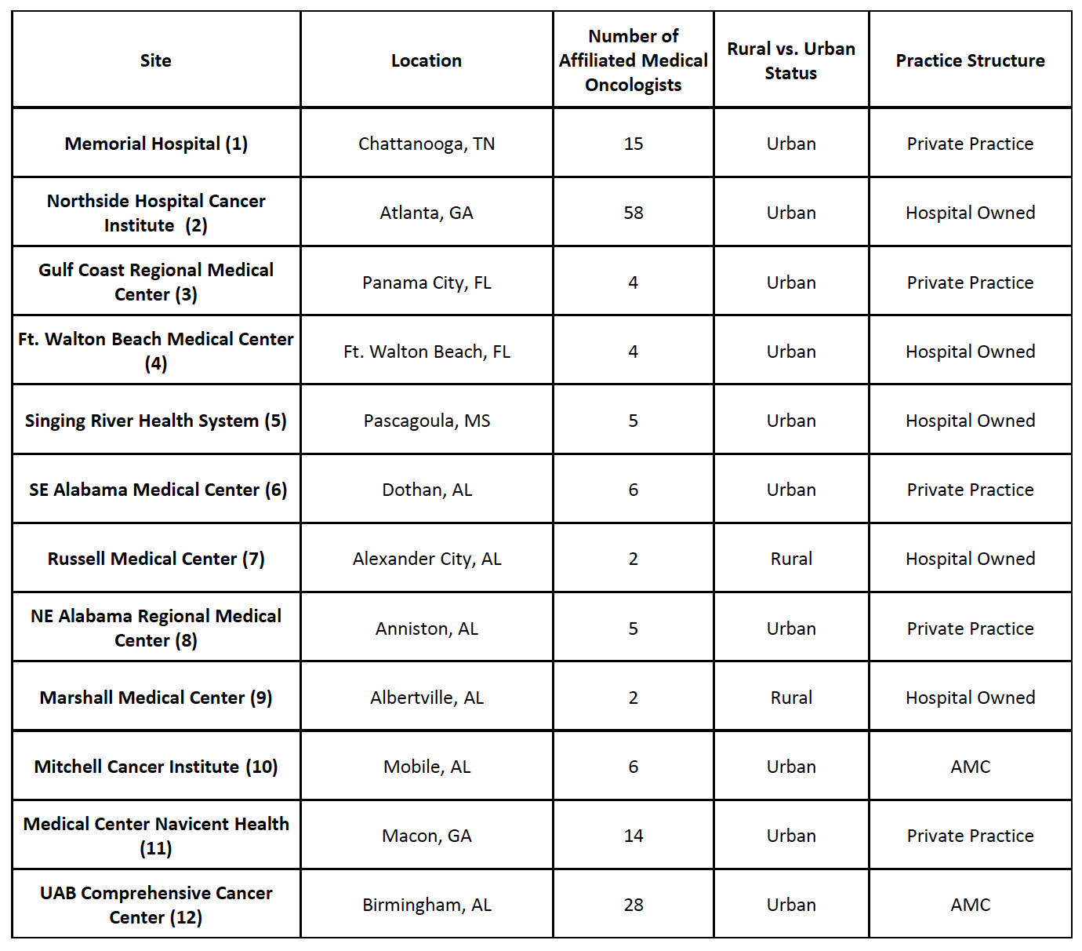
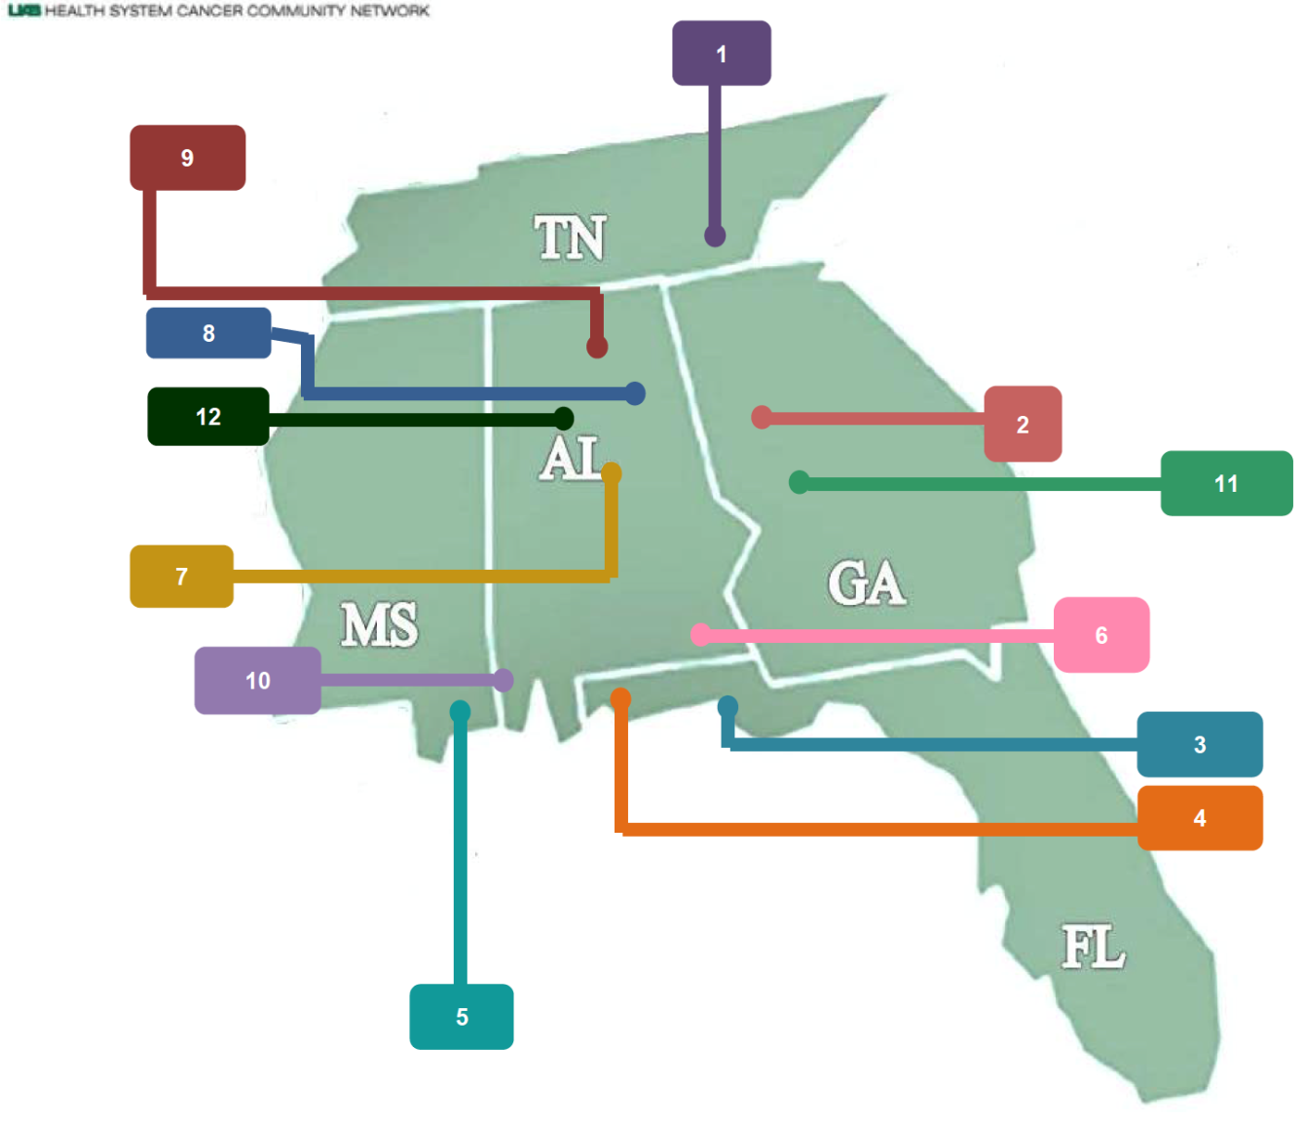
UAB Health System Cancer Community Network

Slide 6
Program Goals
Reduction in emergency room visits.
Reduction in unnecessary hospital days.
Reduction in unnecessary ICU days.
Encourage evidence based clinical pathways.
Encourage earlier adoption of hospice care.
Reduce use of chemotherapy in last 2 weeks of life.
Provide the highest quality of life for people diagnosed with cancer.

Slide 7
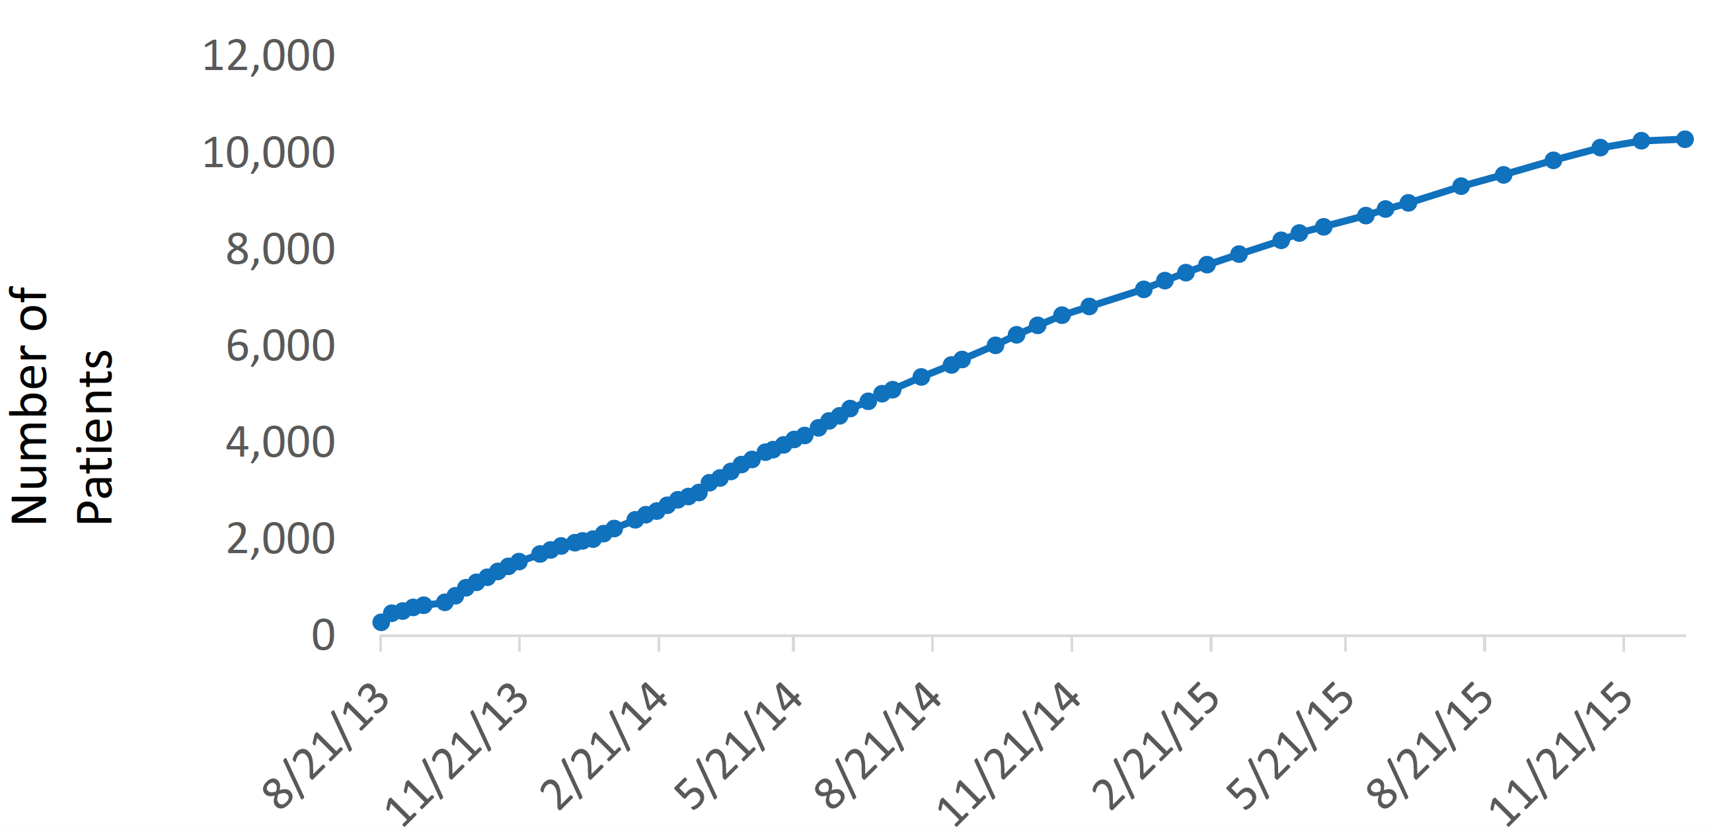
Enrollment in Navigation

Slide 8
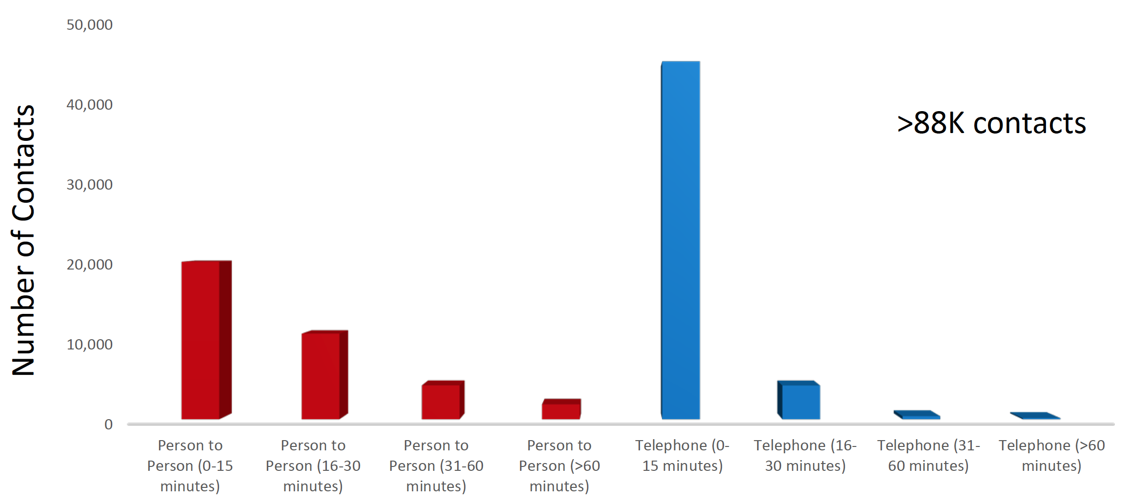
PCCP Patient Contacts (3/2013-12/2015)

Slide 9
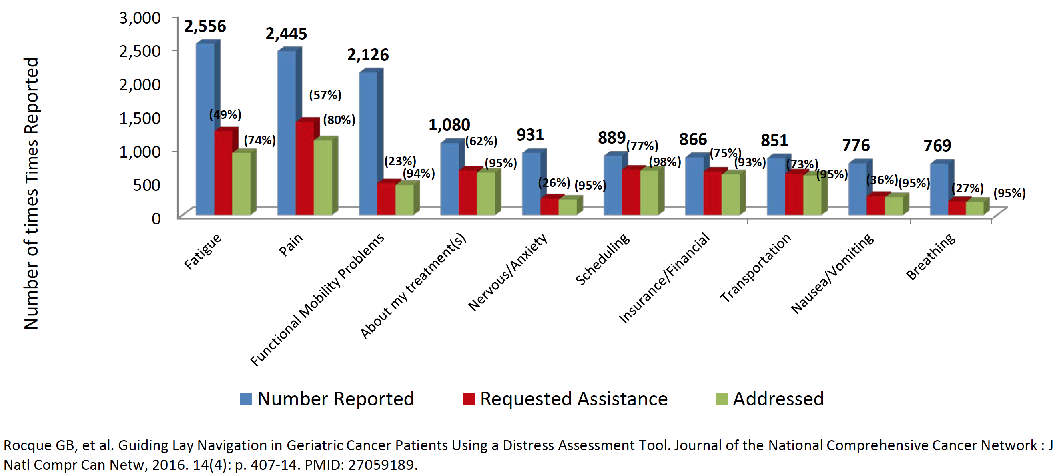
Distress Screening

Slide 10
Cost and Healthcare Utilization After Program Implementation

Slide 11
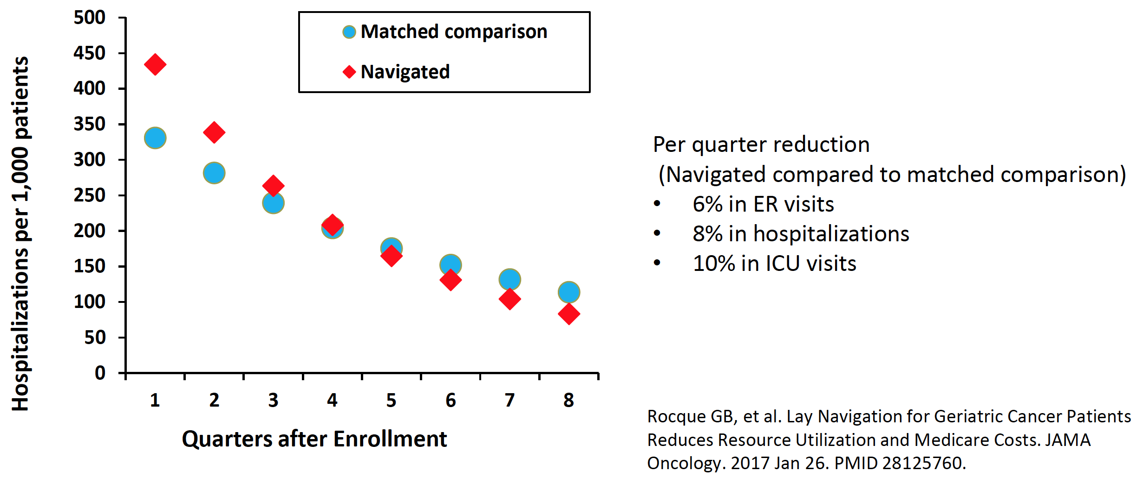
Hospitalizations by Navigation Status

Slide 12
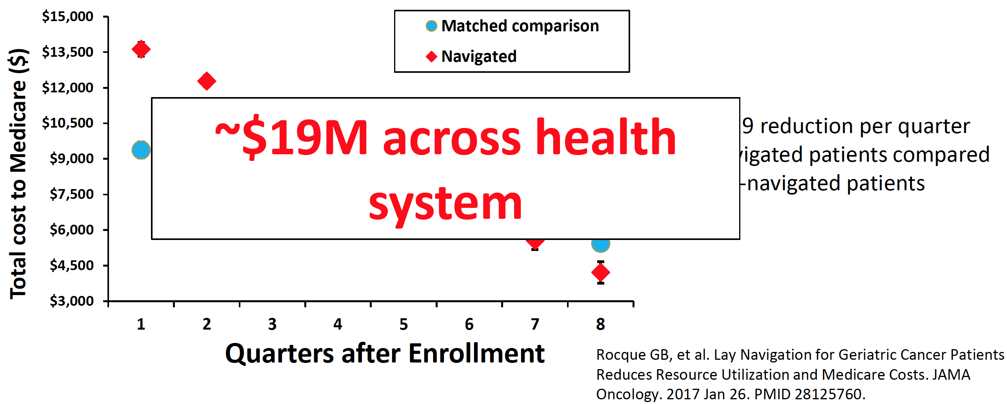
Cost by Navigation Status

Slide 13
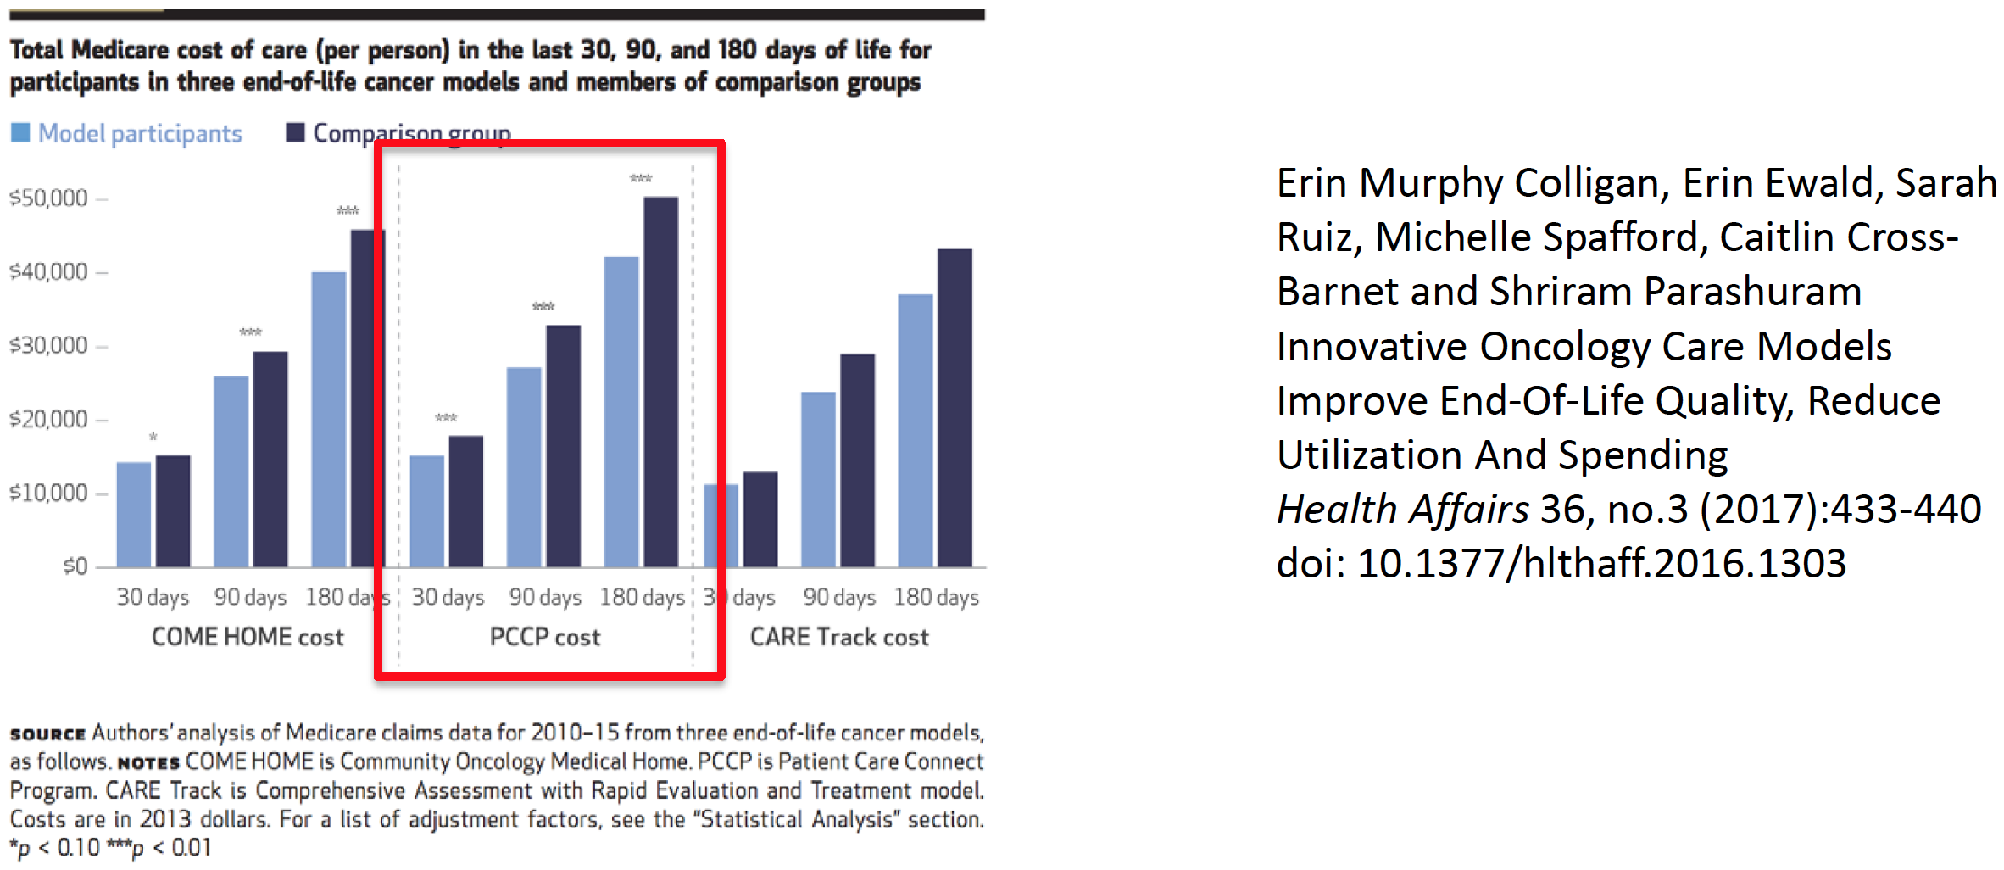
NORC Independent Report

Slide 14
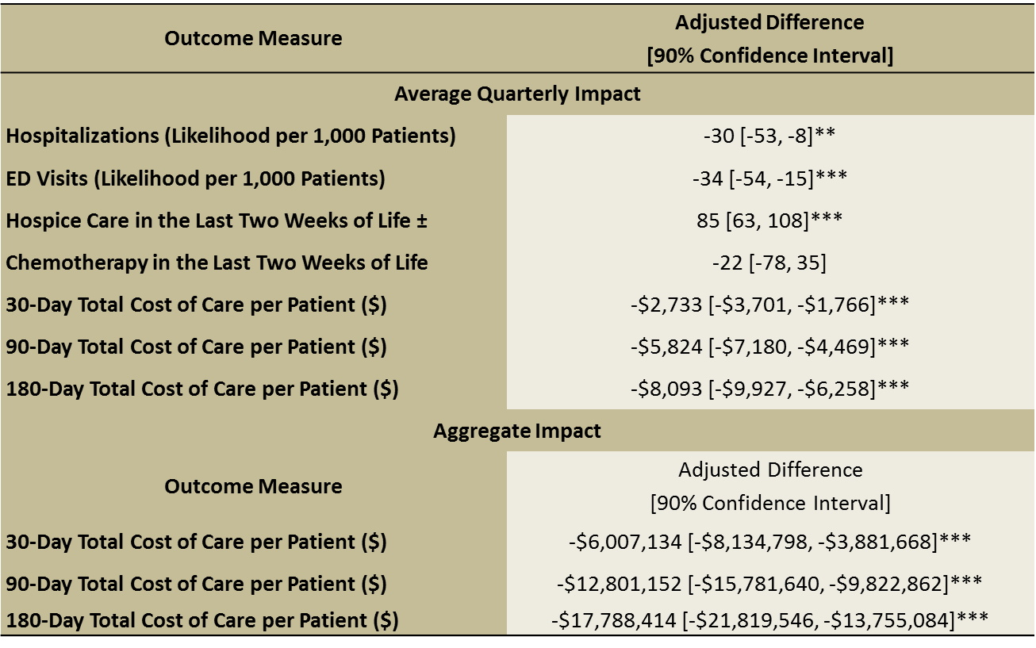
Differences in End-of-Life Utilization, Quality, & Cost between
Decedent UAB Program Participants & Comparison Group Participants

Slide 15
Advance Care Planning
The Institute of Medicine (IOM) recommends ACP
Robust literature showing benefit
Implementation challenges:
Time-consuming
Lack of infrastructure at many institutions
Integration of lay navigator-led ACP aligned with our mission
Rocque GB, et al. Implementation and Impact of Patient Lay Navigator-led Advance Care Planning Conversations. Journal of Pain and Symptom Management. 2017 Jan 3. PMID: 28062341

Slide 16
Respecting Choices®
Nationally recognized ACP program
Training in communication techniques
Scripted facilitation of ACP
Evaluation tools to assess training

Slide 17
Respecting Choices® Training
Online curriculum
6 hour-long modules on ACP facilitation
In-person Skills training
Role play and communication
Practice with site manager
Role play until navigator/site manager is comfortable
Monthly Phone calls across sites
Address administrative/implementation issues
Respecting Choices Facilitator Certification
UAB-specific support

Slide 18
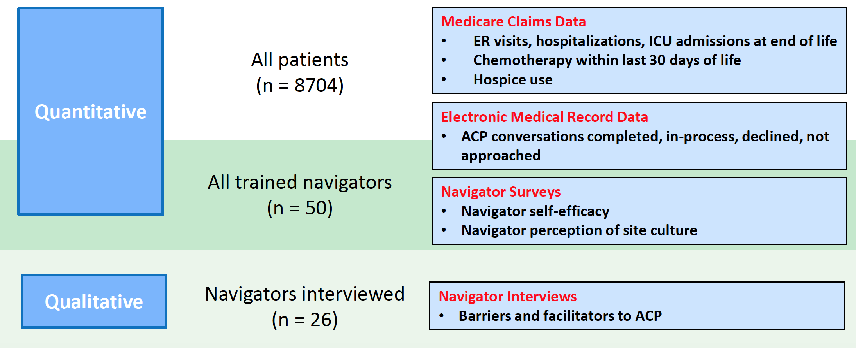
Convergent, Parallel Mixed-Methods Study (June 2014 - Dec 2015)

Slide 19
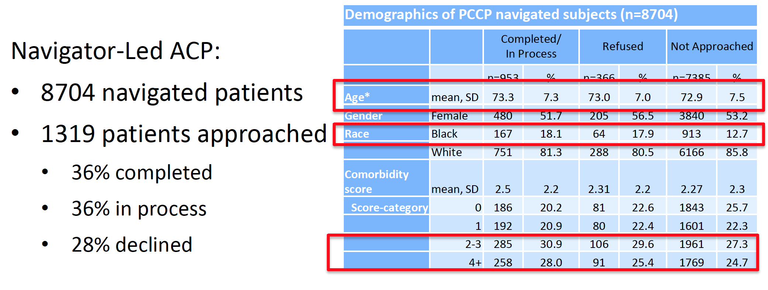
Results: Patient Characteristics

Slide 20
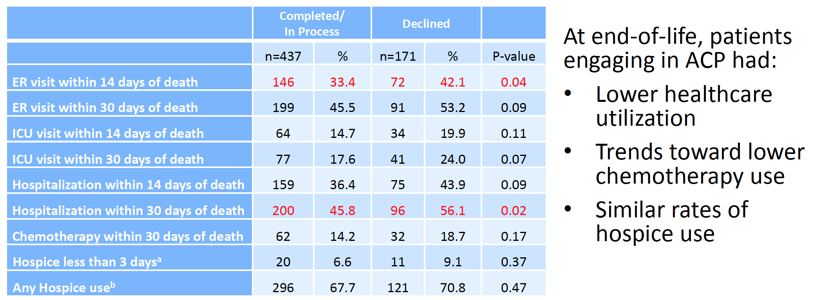
Results: Resource Utilization

Slide 21
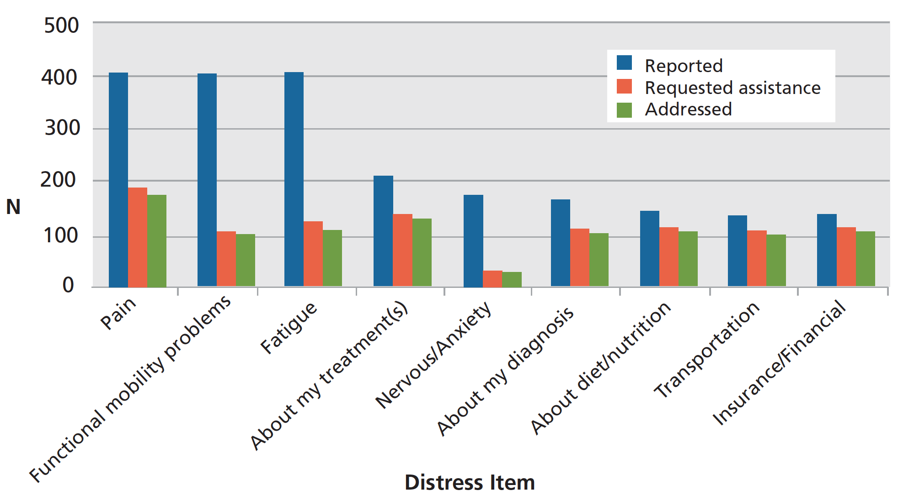
Breast Cancer - Distress Items, Requests for Assistance, & Resolution of Patient Concerns
All Patients
RocqueGB, et al. Guiding Lay Navigation in Geriatric Cancer Patients Using a Distress Assessment Tool. Journal of the National Comprehensive Cancer Network : J Natl ComprCan Netw, 2016. 14(4): p. 407-14. PMID: 27059189.

Slide 22
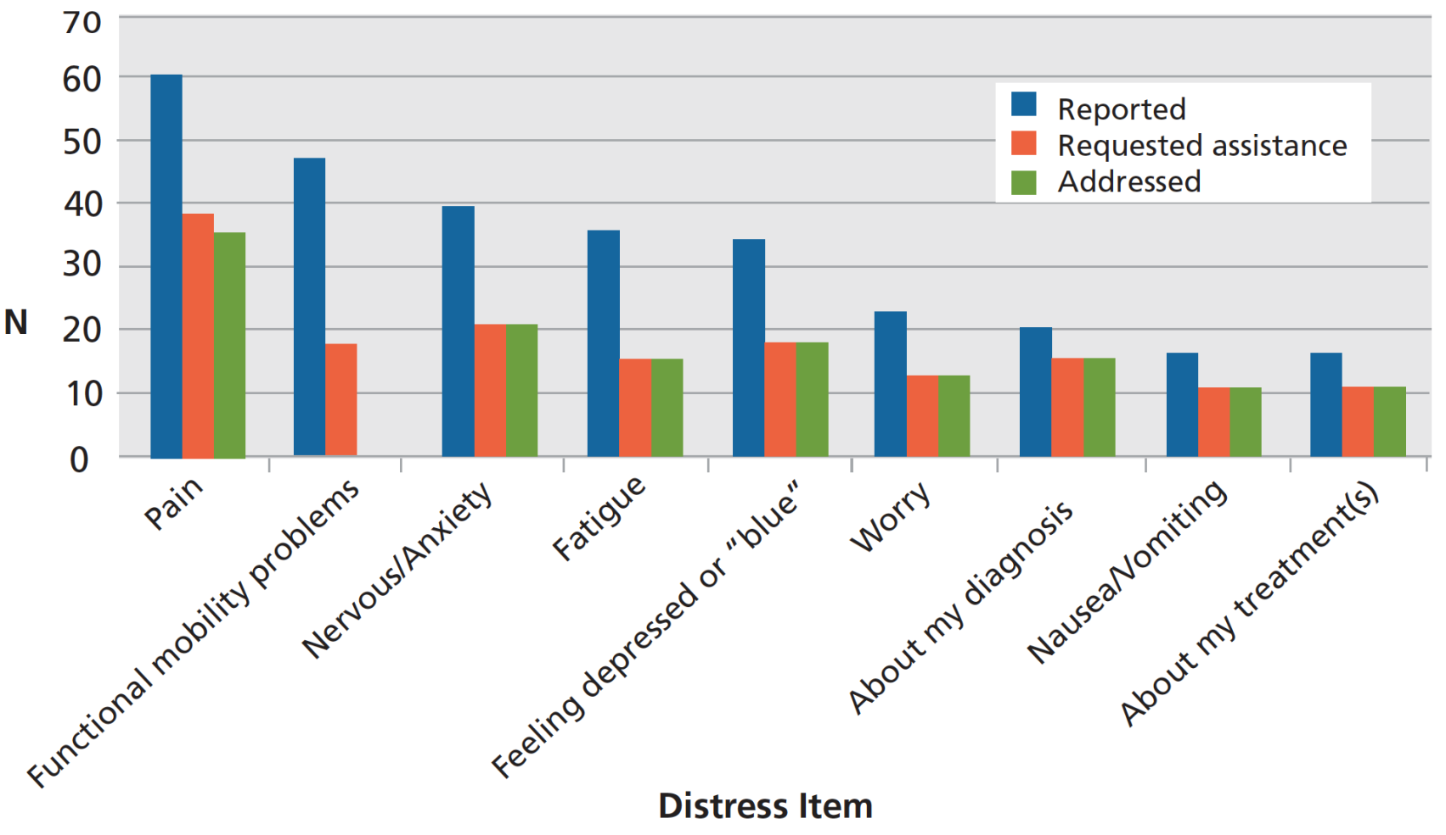
Breast Cancer - Distress Items, Requests for Assistance, & Resolution of Patient Concerns
Patients With a Distress Score of ≥8
RocqueGB, et al. Guiding Lay Navigation in Geriatric Cancer Patients Using a Distress Assessment Tool. Journal of the National Comprehensive Cancer Network : J Natl ComprCan Netw, 2016. 14(4): p. 407-14. PMID: 27059189.

Slide 23
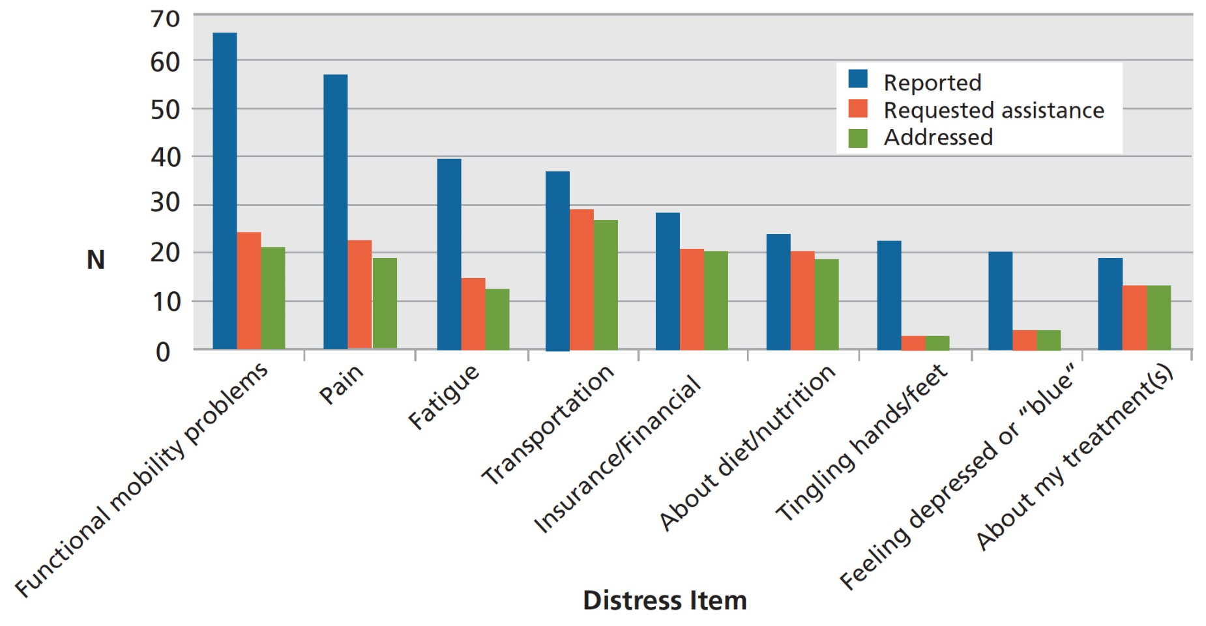
Breast Cancer - Distress Items, Requests for Assistance, & Resolution of Patient Concerns
Minority Patients
RocqueGB, et al. Guiding Lay Navigation in Geriatric Cancer Patients Using a Distress Assessment Tool. Journal of the National Comprehensive Cancer Network : J Natl ComprCan Netw, 2016. 14(4): p. 407-14. PMID: 27059189.

Slide 24
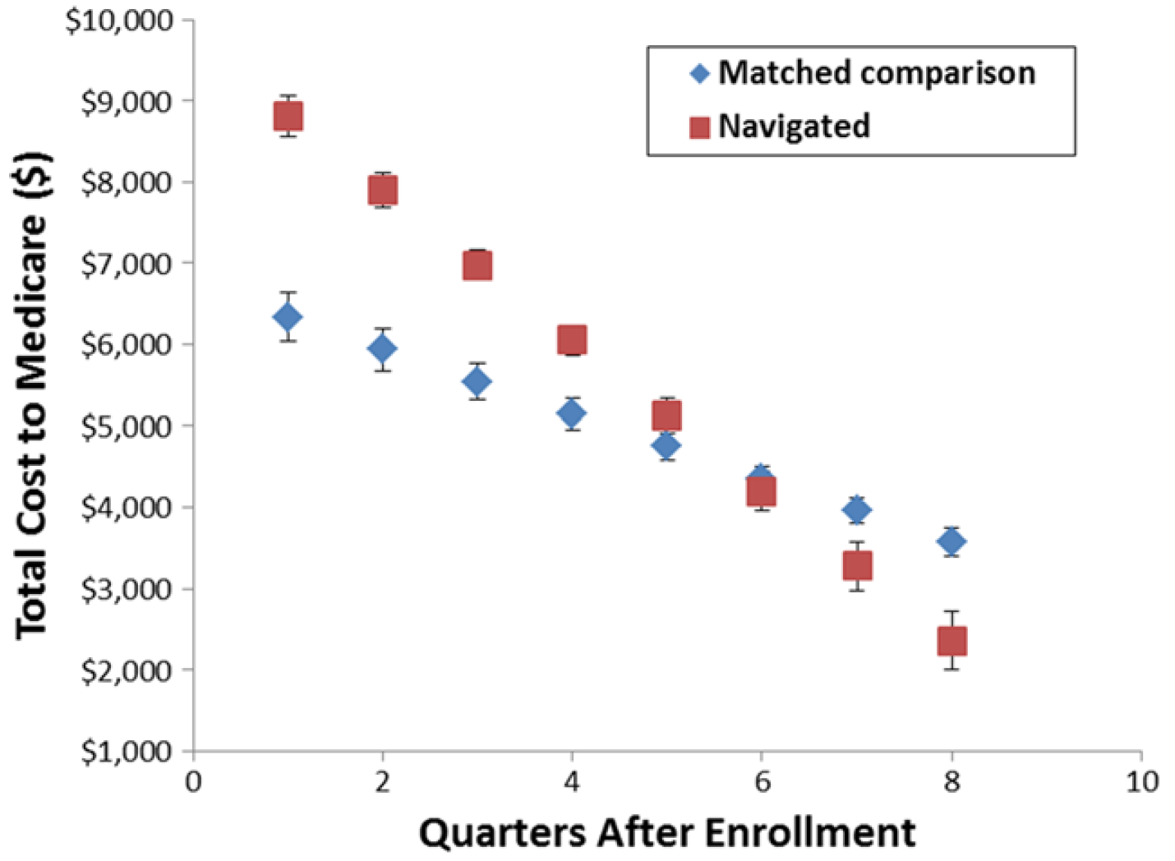
Total Cost to Medicare
Rocque, G.B., Williams, C.P., Jones, M.I. et al. Breast Cancer Res Treat (2018) 167: 215. https://doi.org/10.1007/s10549-017-4498-8

Slide 25
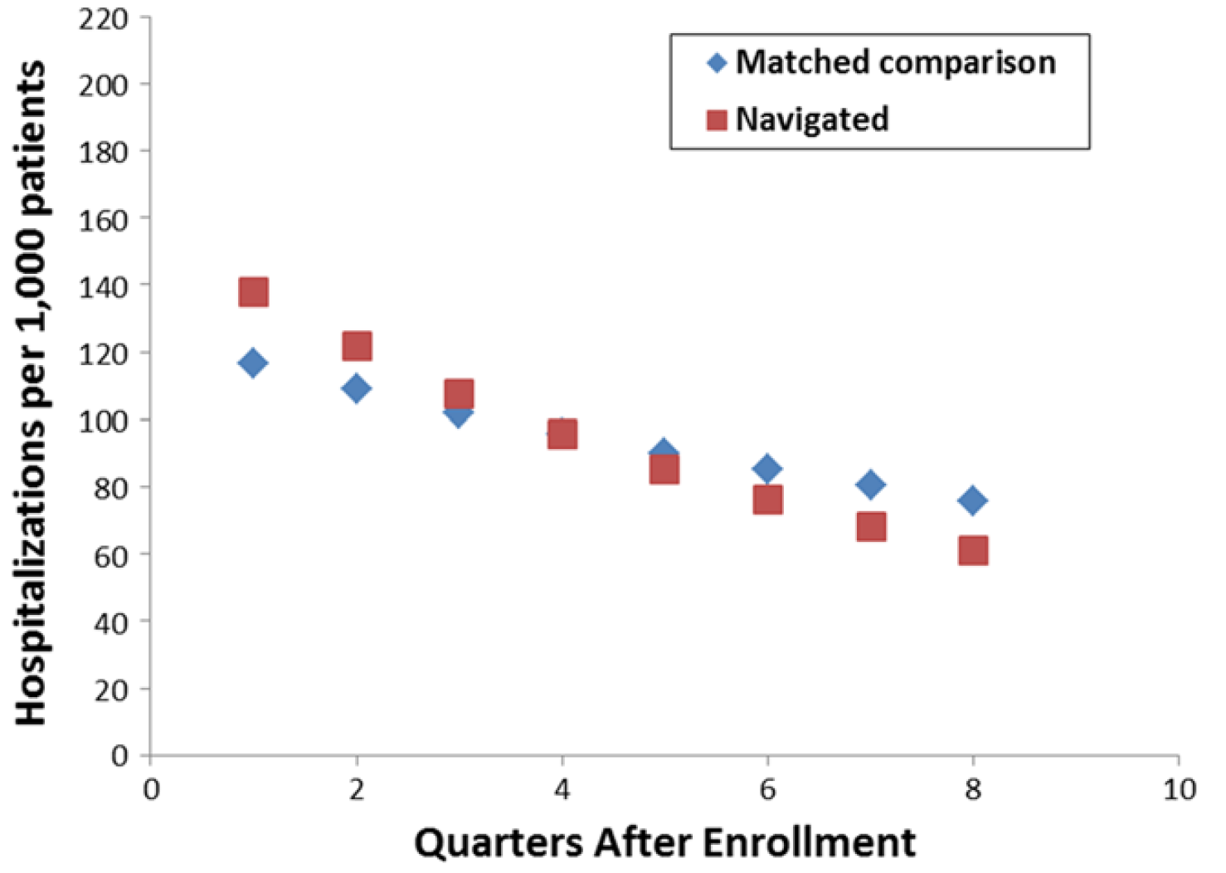
Hospitalizations per 1,000 Patients
Rocque, G.B., Williams, C.P., Jones, M.I. et al. Breast Cancer Res Treat (2018) 167: 215. https://doi.org/10.1007/s10549-017-4498-8

Slide 26
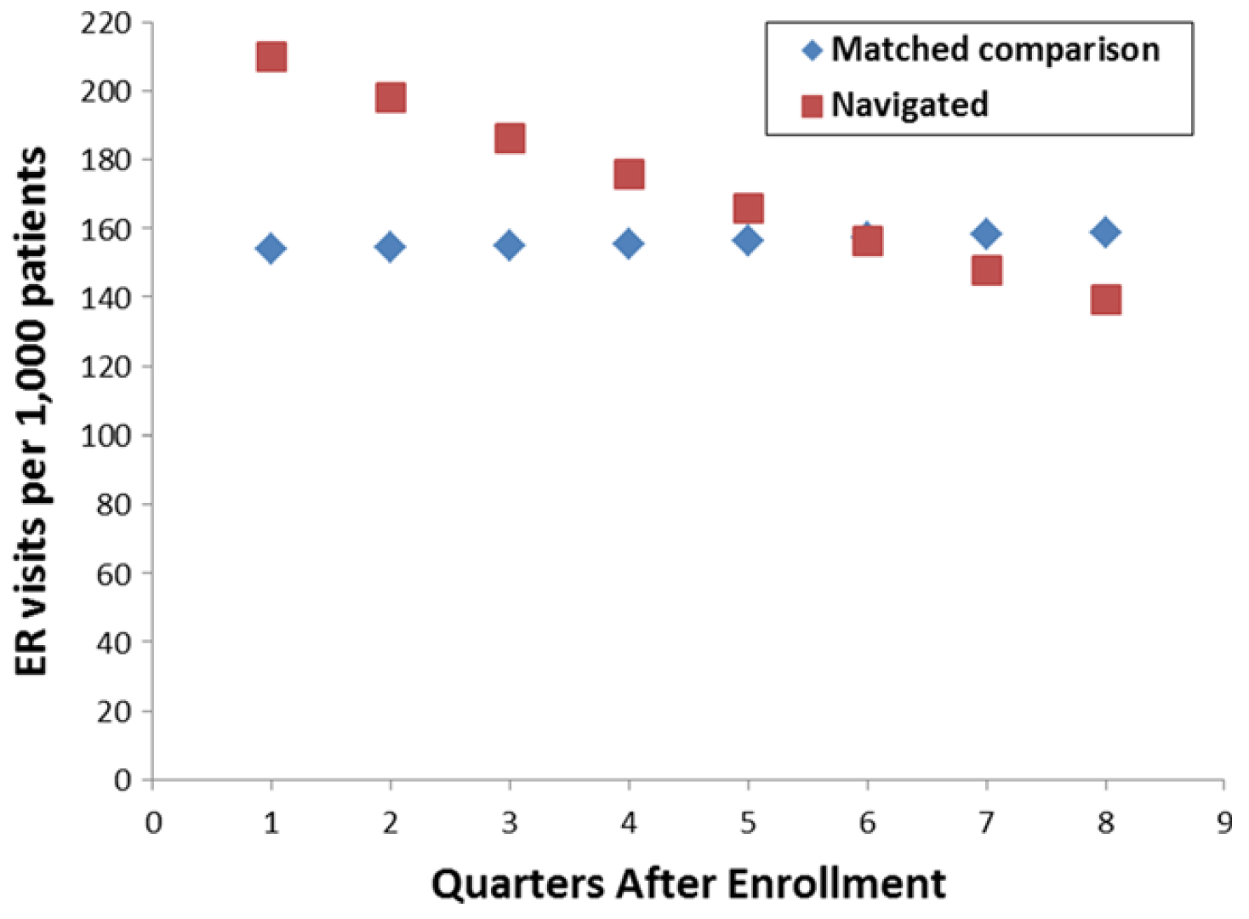
ER Visits per 1,000 Patients
Rocque, G.B., Williams, C.P., Jones, M.I. et al. Breast Cancer Res Treat (2018) 167: 215. https://doi.org/10.1007/s10549-017-4498-8

Slide 27
Sustainability
Payment reform only viable option for sustainability
Medicare → Oncology Care Model
VIVA → Oncology Care Model Collaborator

Slide 28
Oncology Care Model
Opportunity to transform our healthcare delivery system
Be a leader as providers help Medicare define the model
Gain experience with value-based care

Slide 29
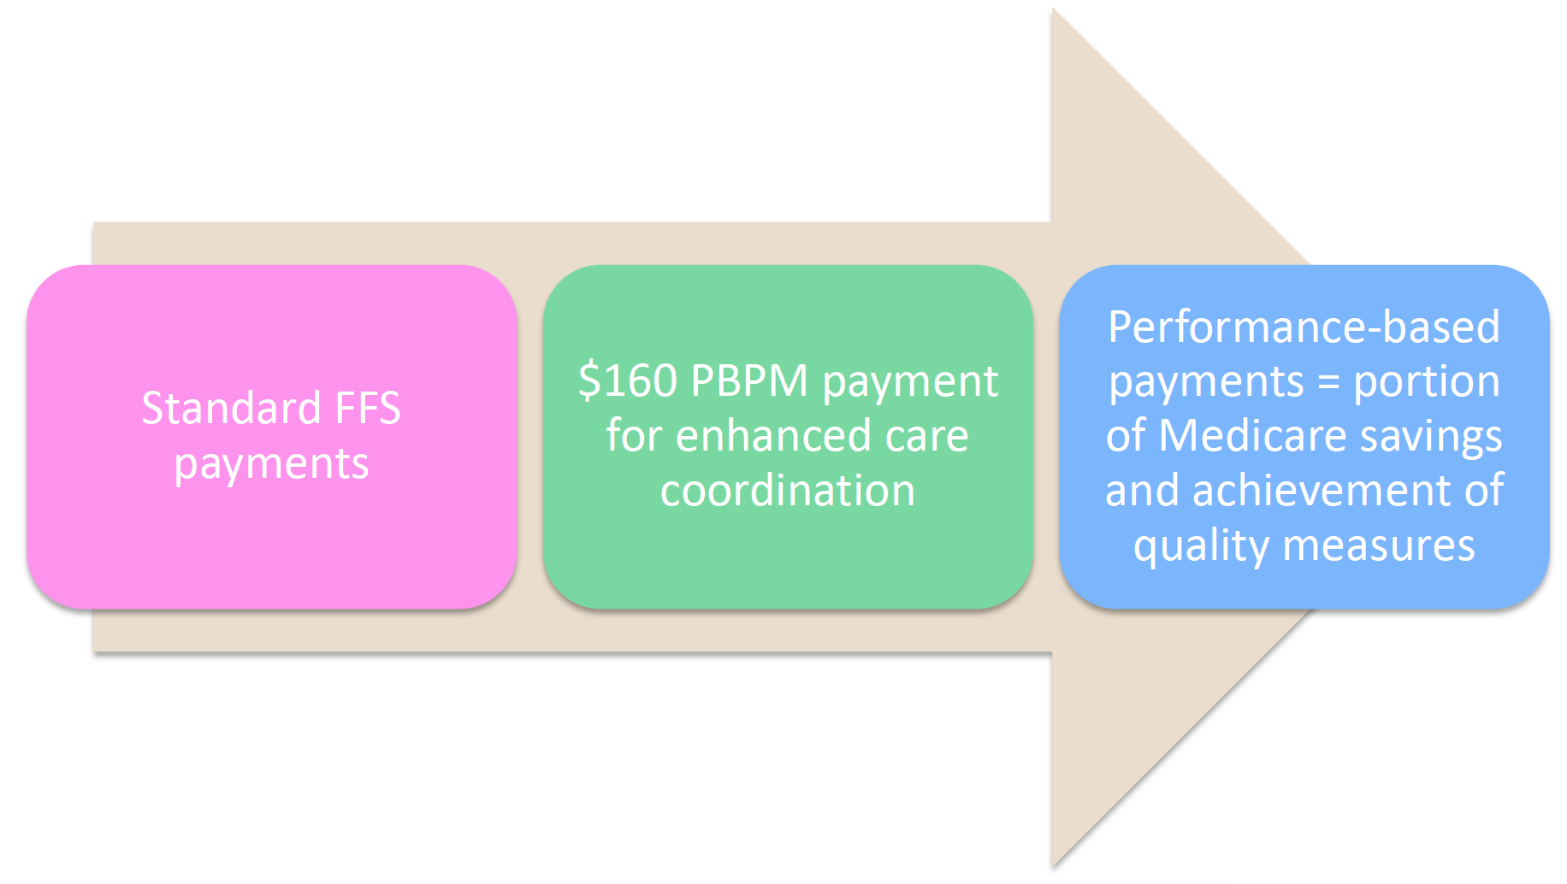

Slide 30
CMS Reconciliation

Slide 31
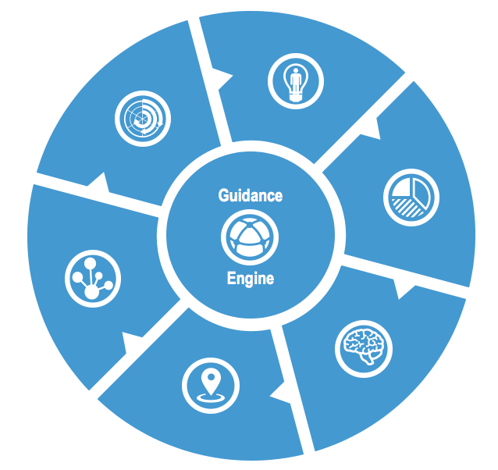
Guideway Care, Inc.
Process: Proven protocols and methodologies
Personalized care through dynamic care maps
Constant refinement of rules/automation based on experience
Growing resource network for higher barrier resolution
Team : Vetted and highly-trained Care Guides with engaged program leadership
Superior job fit
Ongoing training and professional development of skills
Defined career paths and growth opportunities
Professional network
Support Center
Dedicated to your program
Technology: Innovative platform creates scalability and repeatability
Unique system designed specifically for efficiency and automation
Dashboards for users and managers
Customized assessments – Distress, PHQ, Health Literacy, Patient Satisfaction…
Automated and coordinated communications
Continuous refinement

